Slide 1
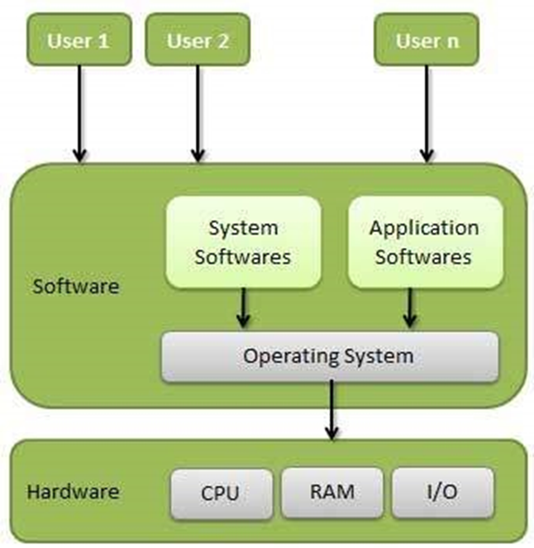
Operating System
An operating system, or "OS," is software that communicates with the hardware and allows other application of the computer to run.
Single- and multi-tasking
Single- and multi-user
Distributed
Templated
Embedded
Real-time
Library

Slide 2
Windows Operating System
Microsoft Windows is a group of several graphical operating system families, all of which are developed, marketed, and sold by Microsoft.
Comparison | MAC | Windows | Linux
SECURITY | No Virus | Many types Virus | Less Virus
PRICE | Too expensive | Less than MAC | Open Source free software
COMPATIBILITY | Only with MAC | All type of software | We can program the software that how we want
RELIABLE | Reliable & smooth | Reliable & Strucks | Not completely

Slide 3
Advantage & Disadvantage of Windows OS
ADVANTAGES | DISADVANTAGES
1. Ease of use | High resource requirements
2. Backwards compatibility | Closed Source
3. Support for new hardware | Poor security & Poor support for older hardware
4. Better Stability | Extortionist prices
5. It supports secure boot | Poor remote access
6. It allows many programs to operate at the same time | Backwards incompatible file formats

Slide 4
Windows workstation and Server

Slide 5
Windows client and server

Slide 6
Features of Windows 7 and Server 2008 R2

Slide 7
Features of Windows 8 and Server 2012 R2

